Slide 1
Week 11:
Event-driven Programming
Inner Classes
Inner Anonymous Classes
Functional interfaces
Lambdas

Slide 2
A quick note about Multithreading
So far, all of our programs run in a single thread. This means that there is a single thread of execution of our code.
Java can do multithreading.
Let’s say we want to have our car washed and our lunch made.
We could hire one person to wash the car and then make us a sandwich. This is single-threading.
Or, we could hire two people and have one wash the car while the other makes us our sandwich! This is multithreading.
Some of the next examples use multithreading but…
The good news is that multi-threading is NOT on the exam ;->

Slide 3
Inner Classes and Inner Static Classes
So, it turns out that we can create Classes inside of classes…
But what exactly does that mean?
Let’s take a look…

Slide 4
Inner Classes
Week-11:innerclasses:Start

Slide 5
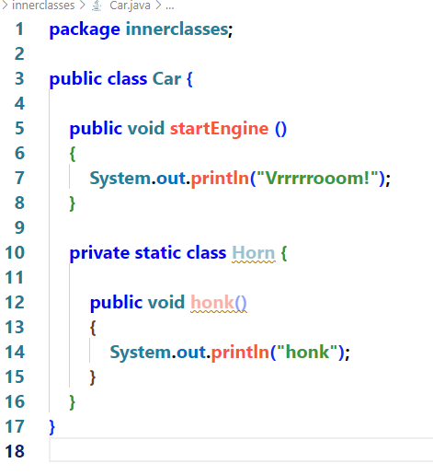
Inner Classes and Inner Static Classes
So, Java can have inner classes.
However, to instantiate the inner class, we either need to make it static or instantiate an instance of the outer class in order to instantiate it.
OK, So what? What’s the point?
Stay tuned!

Slide 6


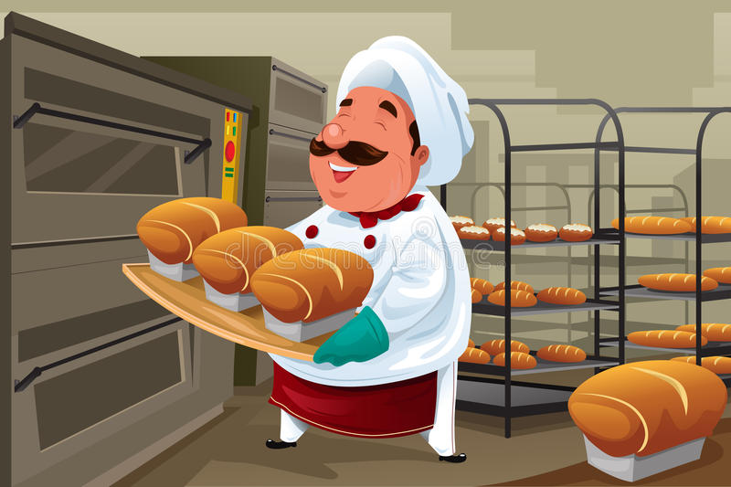

Once upon a time…
There was a land called Javatopia…
Notes:
And in that land, there was a small town called Eventville
<CLICK>
And, in Eventville,there was on old man who lived on the top of a hill and baked bread for the townspeople
Now, the old man baked the best bread in all of Javatopia and the villagers all wanted his bread!
The problem was that the old man was somewhat inconsistent. The bread could be ready any time between 9:00am and 4:00pm each day that was that.
This meant that a villager who wanted to purchase bread from the old man would have to wait outside of his bakery, at the top of the hill, all day, until the bread was ready!
Unfortunately, lining up all day, waiting for bread, prevented the villagers from doing anything useful until the bread was done. This led the townsfolk to try to guess when the bread was going to be done. Guess too early and they ran the risk of wasting hours waiting and guessing too late ran the risk of the bread selling out before they got there!
This was just how it was.
<CLICK!>That is, until a young girl had a brilliant idea. She approached the townsfolk and said: “If you register with me (for a small fee ;->), <CLICK!> I will wait at the bakery for the baker to complete the day’s bread. At that point, I will get one of my employees (other friends) to run to your house with a list of available bread and ring your doorbell. You just have to listen for your doorbell.
Well, this was a great solution! The townspeople could now go about their daily routine, confident that they would be notified when it was time to go to the bakers!

Slide 7
Event Source
Event Dispatcher
List of registered listeners
Registered as an event listener
Registered as an event listener
Notes:
So, what does this story have to do with Event-Driven programming? Well, actually, it is event-driven programming!
In the story,
The Baker – Event source
Young Girl – Event Dispatcher
Girl’s Friends that run to the subscribed houses with a list of bread – Event Object
Each townsfolk that subscribes to the girl’s service – Event Listener
List of townsfolk using this service – listener queue
The steps that the Townsperson completes after receiving the event object and acting on the event – event handler
The townsperson registers with the young girl by adding themselves to the ‘listener list’.
Baker (Event Source) completes baking and produces List of Bread for Today (Event Object) and hands it to the young girl (event dispatcher).
The young girl starts at the top of his list of townspeople (listeners) and dispatches one of her employees to that townsperson with the list of bread for today (event object).
The employee rings the doorbell and the townsperson hears it. The employee hands the list of bread (event object) to the townsperson.
At this point, the townsperson can handle the event (event handler) by deciding how they want to react to the news that the bread is ready.

Slide 8




Event Source
Baker finishes baking bread (Event occurs)
Event Dispatcher builds lists of bread available (Event Object)
Event Dispatcher sends the list of bread to each of the registered listeners (calls each listener and passes the event object to the event handler)
Listeners handle the event by purchasing bread.
Life is good!
Event Dispatcher
List of registered listeners

Slide 9
Welcome to Javatopia!
Week-11:javatopia:Start

Slide 10
Hmmm… Event Source and Event Dispatcher
Quite often they are written in the same class

Slide 11
Hmmm… Event Listener and Event Handler
Kind of two sides of a coin.
The object itself is the listener, but the method is the handler.
More recently, we tend to just say that we register the event handler.
Event listener terminology has fallen out of favour.
However, it still pops up in the occasional interview question

Slide 12
javatopia.Start – see yourturn comment (Jerry the mouse)

Slide 13
By the way…
Do you notice that Event-Driven programming doesn’t work without polymorphism? Without that polymorphic interface, BreadEventListener would have to be a concrete class so only BreadEventListener objects could listen for events
Because of polymorphism, any class that implements BreadEventListener can be registered as an event listener and react to bread Events
Without a polymorphic interface, we couldn’t have added the Mouse class to be a listener
Polymorphism is super powerful!!!

Slide 14
Gui’s use event-driven programming
Imagine how we would handle events in a GUI application if we didn’t use event handling.
We would have to write a huge loop that would have to check every possible thing that could happen, in every iteration of the loop:
Did the user type a ‘p’
Did the user type a ‘(‘
Did the user move the mouse?
Did the user click the mouse?
Did the user select this menu item?
Did the user select that menu item?
Etc.

Slide 15
With event-driven programming…
Any code that is interested in any particular event can just add itself as a listener for the event and we can rest happily, knowing that the code will fire when that event happens!

Slide 16
GUI
Week-11:gui.Start

Slide 17
Yourturn 1a

Slide 18
Lambdas
Lambdas are a way to make our anonymous classes even smaller

Slide 19
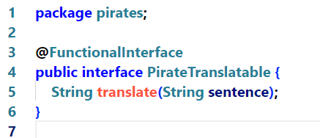
Before we talk about lambdas, we have to know what a functional interface is
Lambdas work with ‘Functional Interfaces’
A good idea!
A Functional interface is just a fancy way of saying an interface with only one abstract method.
That’s it. Nothing scary! Just an interface with only one abstract method.

Slide 20
Pirates!
Week 11: pirates

Slide 21
Remember…
Lambdas work with ‘Functional Interfaces’
A Functional interface is just a fancy way of saying an interface with only one abstract method.
That’s it. Nothing scary! Just an interface with only one abstract method.

Slide 22
The making of a lambda expression
We already know how to make anonymous inner classes. The classes make our code easier as we don’t have to put them in separate files.
Lambdas extend this idea of making our code more succinct by allowing us to streamline our inner classes.
Java uses syntactic sugar for a lot of this!

Slide 23
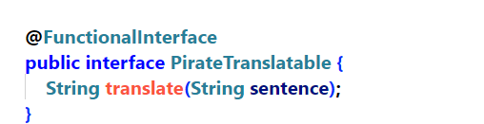
We start with a functional interface…

Slide 24
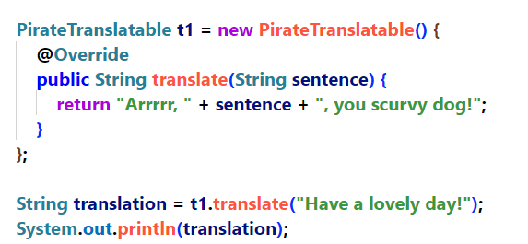
From there, we can make an anonymous, inner class

Slide 25
Finally, we can turn our anonymous, inner-class into a lambda expression

Slide 26
Finally, we can turn our anonymous, inner-class into a lambda expression
Hmmm…functions don’t need objects

Slide 27
Finally, we can turn our anonymous, inner-class into a lambda expression
Hmmm…functions don’t need objects
Since we are implementing a functional interface, we don’t need to know the name of the method (function) There is only one method!

Slide 28
Finally, we can turn our anonymous, inner-class into a lambda expression
Hmmm…functions don’t need objects
Since we are implementing a functional interface, we don’t need to know the name of the method (function) There is only one method!
Public is no longer needed as it is only accessible by the lambda expression

Slide 29
Finally, we can turn our anonymous, inner-class into a lambda expression
Hmmm…functions don’t need objects
Since we are implementing a functional interface, we don’t need to know the name of the method (function) There is only one method!
public is no longer needed as it is only accessible by the lambda expression
The compiler is now smart enough to know what value types are passed in and what value type is returned so we don’t need to add that information

Slide 30
Finally, we can turn our anonymous, inner-class into a lambda expression
Hmmm…functions don’t need objects
Since we are implementing a functional interface, we don’t need to know the name of the method (function) There is only one method!
public is no longer needed as it is only accessible by the lambda expression
The compiler is now smart enough to know what value types are passed in and what value type is returned so we don’t need to add that information
Since our function is only one line long, The compiler knows what is being returned so we don’t need a return keyword
Note: If our function was more than 1 line long, we’d still need the return statement

Slide 31
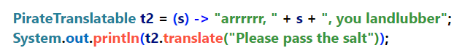
Finally, we can turn our anonymous, inner-class into a lambda expression
Hmmm…functions don’t need objects
Since we are implementing a functional interface, we don’t need to know the name of the method (function) There is only one method!
public is no longer needed as it is only accessible by the lambda expression
The compiler is now smart enough to know what value types are passed in and what value type is returned so we don’t need to add that information
Since our function is only one line long, The compiler knows what is being returned so we don’t need a return keyword
What is left?
Technically, if there is only one parameter, we can even do away with the ( )s
We need to add the lambda

Slide 32
Bottom Line!
You will hear other programmers talk about lambda this and lambda that…
But remember, a Lambda is nothing more than an anonymous inner class that implements a Functional Interface (an interface with only one abstract method)
The whole lambda syntax just let’s us write these classes in an easier fashion

Slide 33
Week-11:yourturn 2A and 2B

Slide 34
YourTurn2 a and b
Let’s do it together!

Slide 35
Yourturn 1b

Slide 36
Yourturn 1b
Let’s do it together!

Slide 37
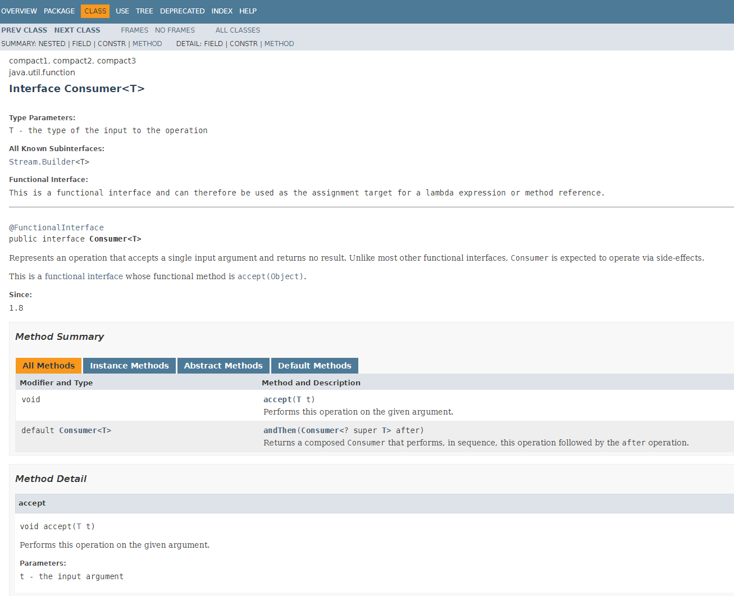

Slide 38
Yourturn3.Start

Slide 39
Yourturn4.Start

Slide 40
Yourturn5.Start For supersmartypants only!

Slide 41
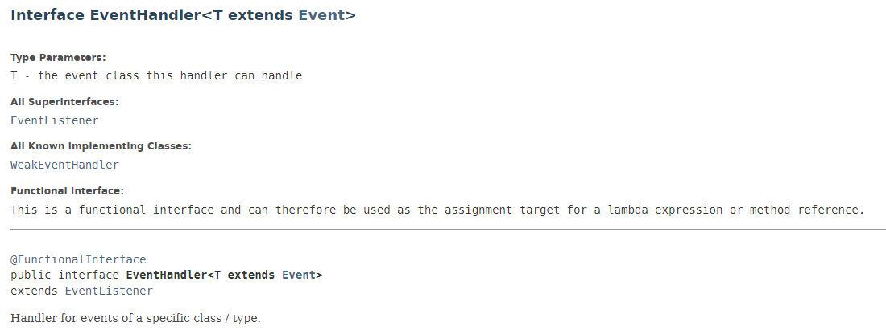
By the way, remember the buttons? The Java FX EventHandler is a functional interface
What does that mean, again?

Slide 42
So, let’s talk about our lambda Expression
What if our EventHandler interface had two abstract methods?
Hmmm…could we use Lambda?
No! In order to use lambdas, the objects that we build must have only one abstract method.
We call an interface with only one abstract method, a Functional Interface

Slide 43
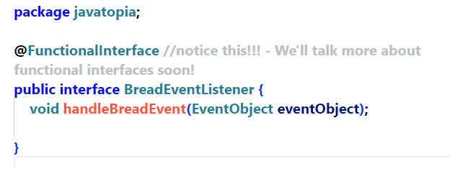
@FunctionalInterface annotation
A good idea!
Notes:
Adding the @FunctionalInterface to our functional interfaces prevents programmers from not realizing that this interface can only have one abstract method. Without it, someone might add a second abstract interface and break all of the lambda expressions that use this interface.

Slide 44
Review
We can create a separate class that implements our event handler interface and register the resulting object it as a listener
We can create an inner class implements our event handler interface and register the resulting object as a listener.
We can use an anonymous, inner class and register that object as a listener
If our interface only has one abstract method, we can use a lambda expression to instantiate and register our event handler object.
Lambda expressions are a way for us to build anonymous, inner classes in the most compact way possible
We call interfaces with a single, abstract method, Functional Interfaces. Functional Interfaces can make use of lambdas

